Slide 1
Activation distribution in a neural network
Martin Ayvazyan
20 August 2018
Source: Notes are in Tahoma, regular, 8 point, italic, flush left, vertically aligned from the bottom of text box.

Slide 2
Contents
Why are neural networks so important
Basic network characteristics
Basic description of the process, formulation of algorithms, comparison of behavioral characteristics
Common behavioral characteristics of the process
A visual representation of the process
Core characteristics of the software

Slide 3
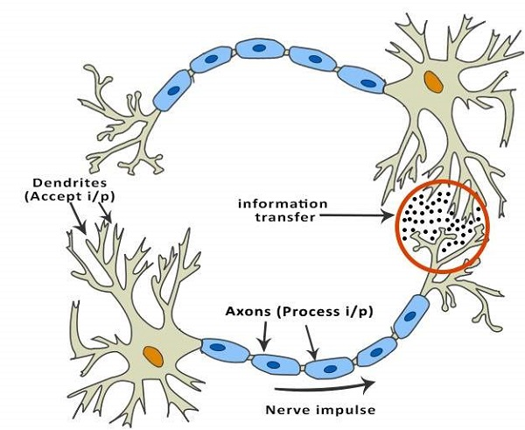
Basic Structure of ANNs

Slide 4
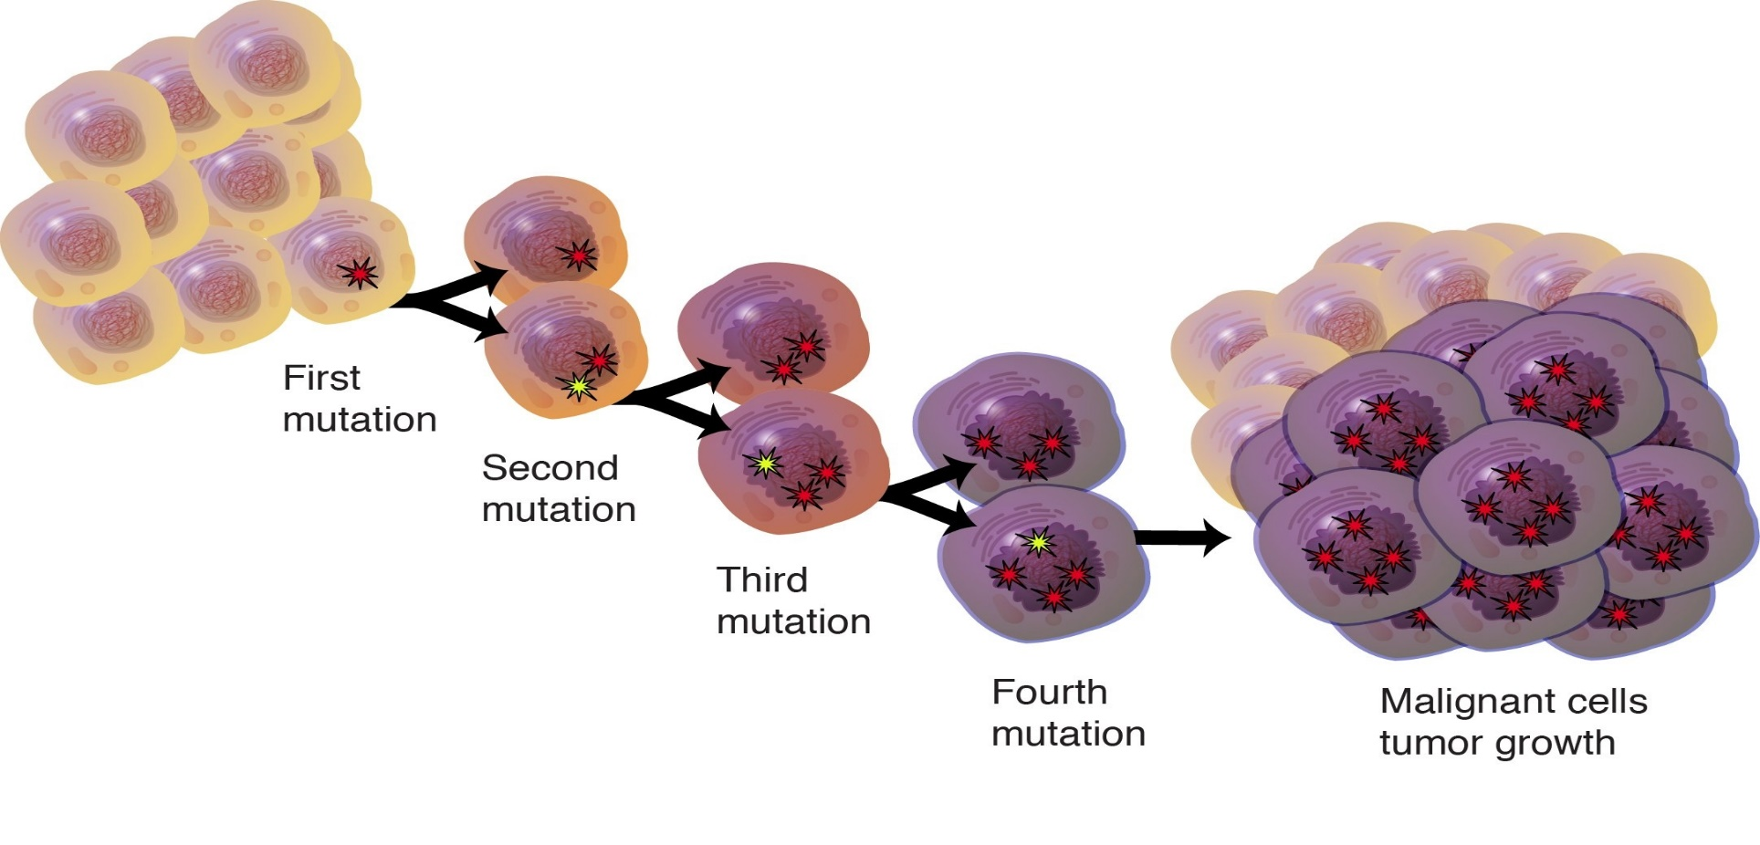
Cell Division and Cancer

Slide 5
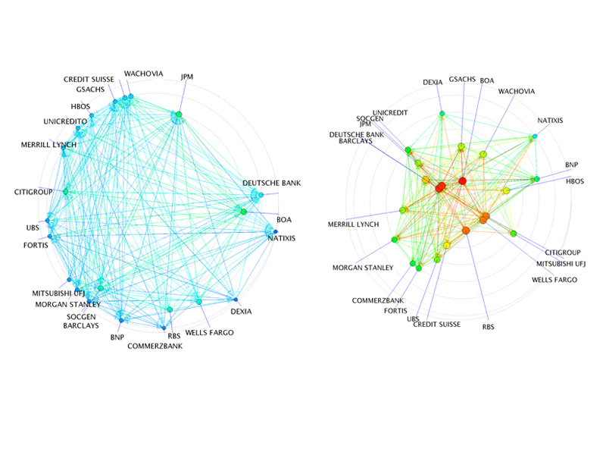
The global economic crisis prevention / elimination

Slide 6
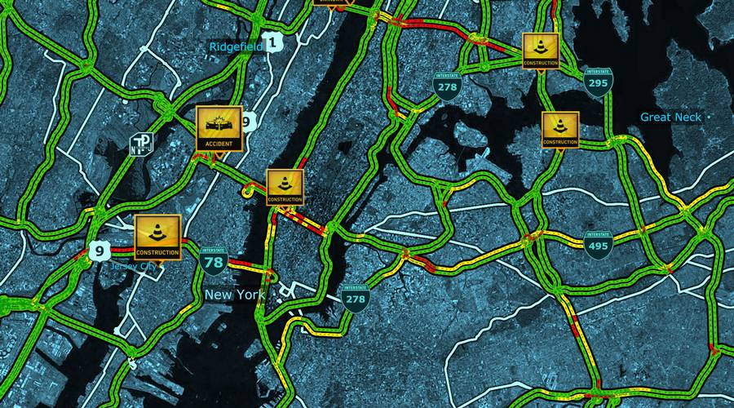
Traffic control / jams prevention

Slide 7
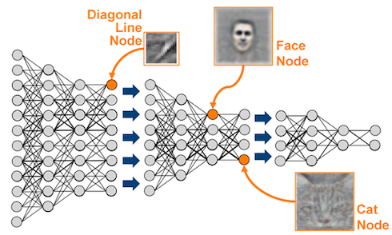
Deep learning

Slide 8
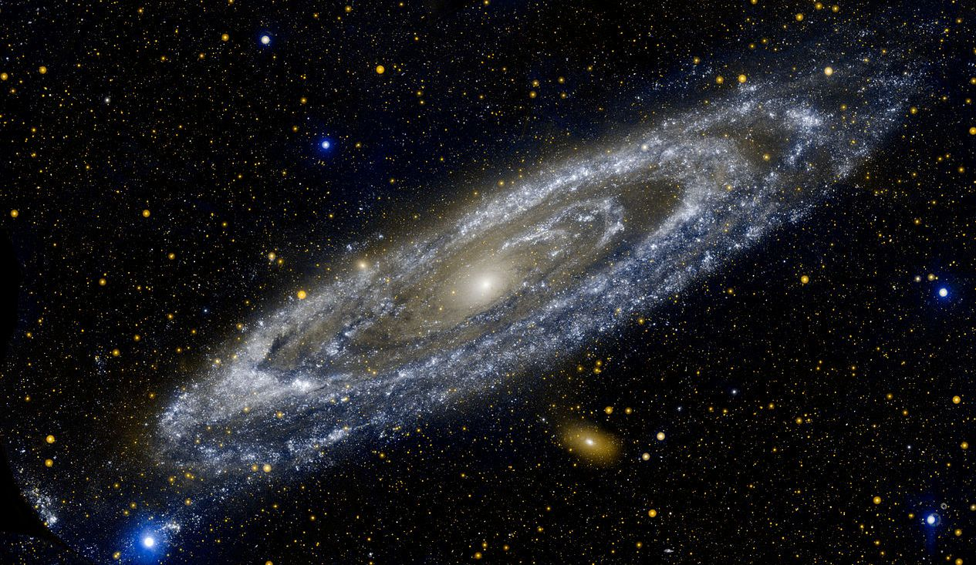
Astronomy

Slide 9
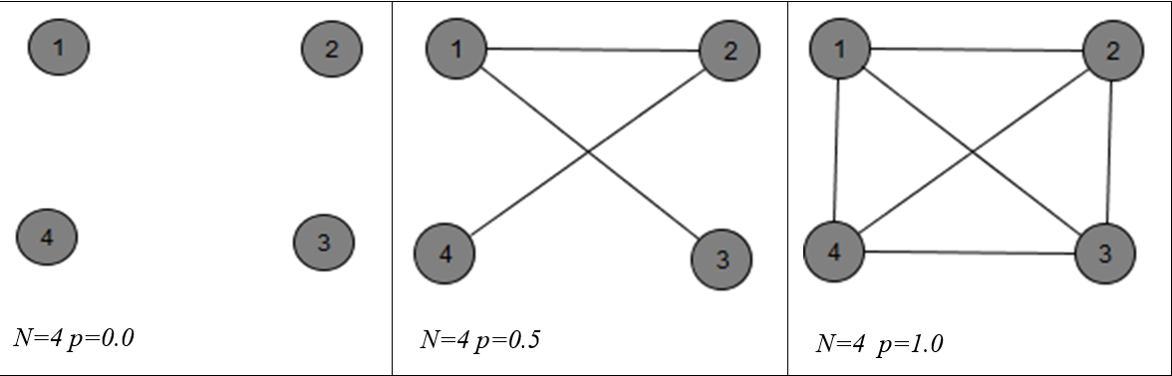
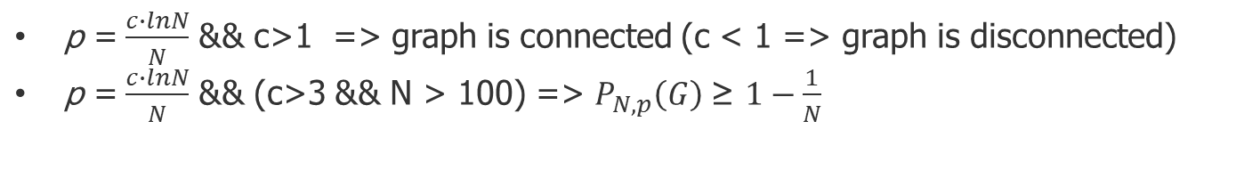
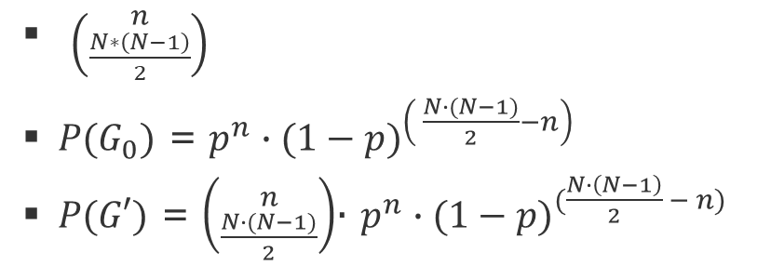
Basic definitions
ER model G(N, p) N – nodes count in the graph p – component of connectivity P(G) – the probability that the graph is connected
$\left({n \atop \frac{N∗\left(N−1\right)}{2}}\right)$
$P(G_{0})$ = $p^{n}∙{(1−p)}^{\left( \frac{N∙(N−1)}{2}−n\right) }$
$P(G′)$ = $\left({n \atop \frac{N∙(N−1)}{2}}\right)$∙ $p^{n}∙{(1−p)}^{(\frac{N∙\left(N−1\right)}{2} − n)}$
p =$\frac{c∙lnN}{N}$ && c>1 => graph is connected (c < 1 => graph is disconnected) p =$\frac{c∙lnN}{N}$ && (c>3 && N > 100) => $P_{N,p}\left(G\right)$≥ $1−\frac{1}{N}$

Slide 10
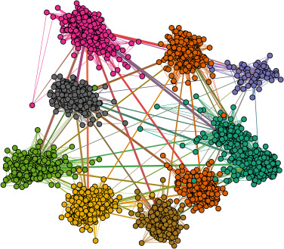
Small world

Slide 11
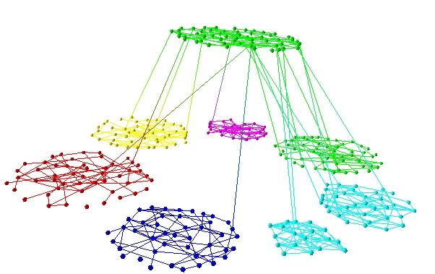
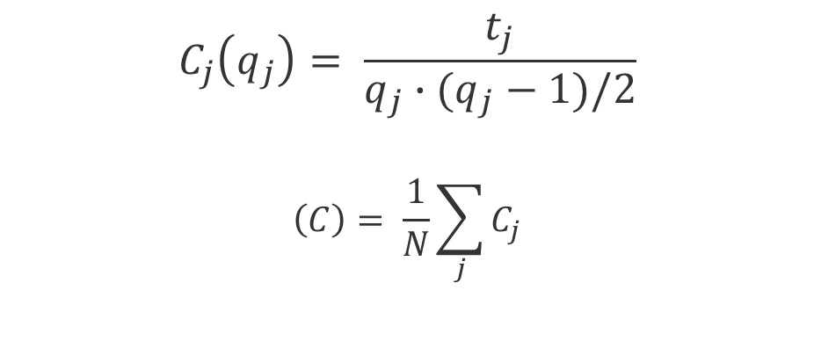
Clusterization
$$C_{j}\left(q_{j}\right)= \frac{t_{j}}{q_{j}∙(q_{j}−1)/2}$$ $$\left(C\right)= \frac{1}{N}\sum_{j}{C_{j}}$$

Slide 12
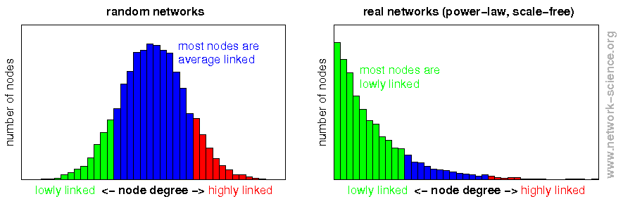
Degree distribution

Slide 13
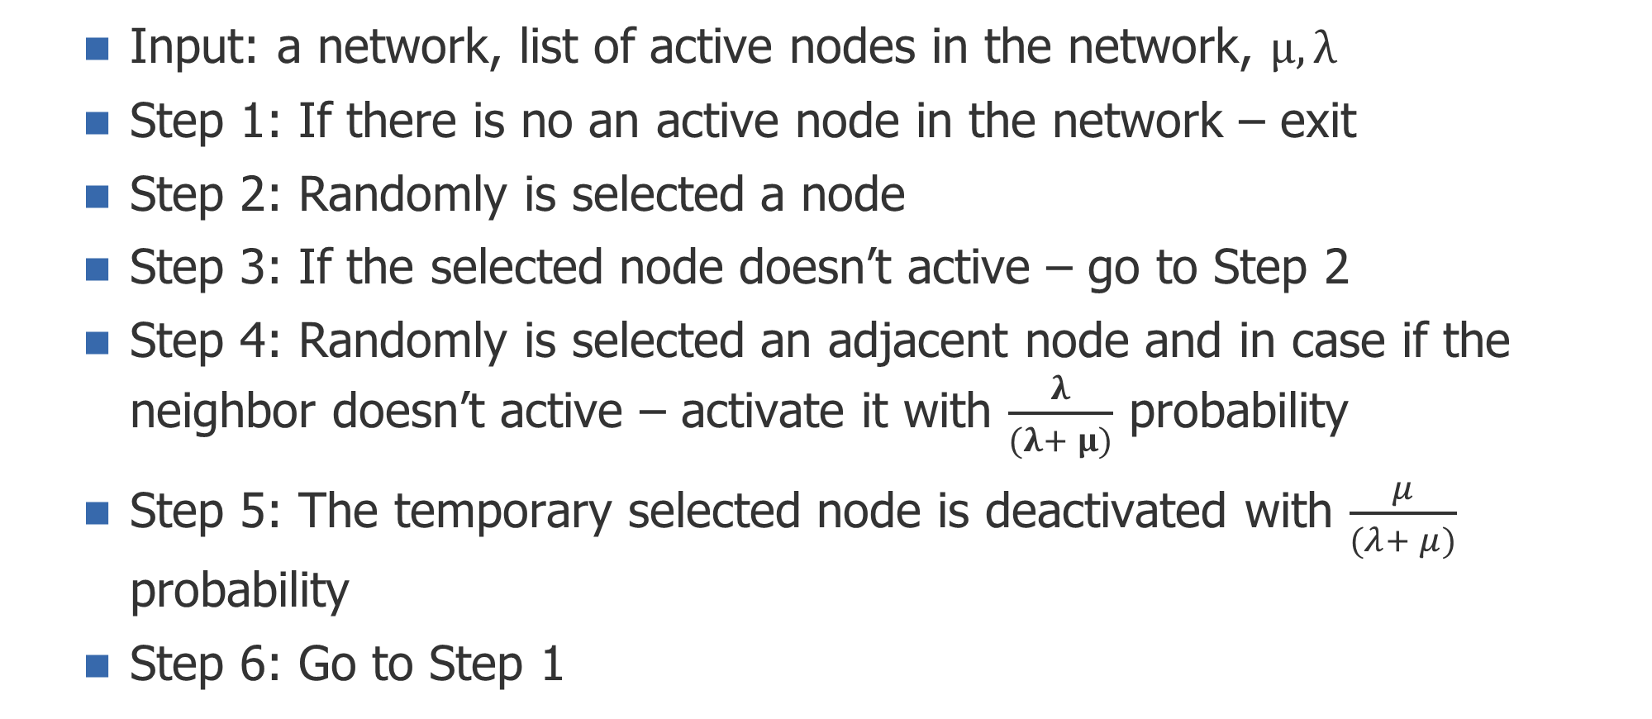
Algorithm A
Input: a network, list of active nodes in the network, $μ, λ$
Step 1: If there is no an active node in the network – exit
Step 2: Randomly is selected a node
Step 3: If the selected node doesn’t active – go to Step 2
Step 4: Randomly is selected an adjacent node and in case if the neighbor doesn’t active – activate it with $\frac{λ}{(λ+ μ)}$ probability
Step 5: The temporary selected node is deactivated with $\frac{μ}{(λ+ μ)}$ probability
Step 6: Go to Step 1

Slide 14
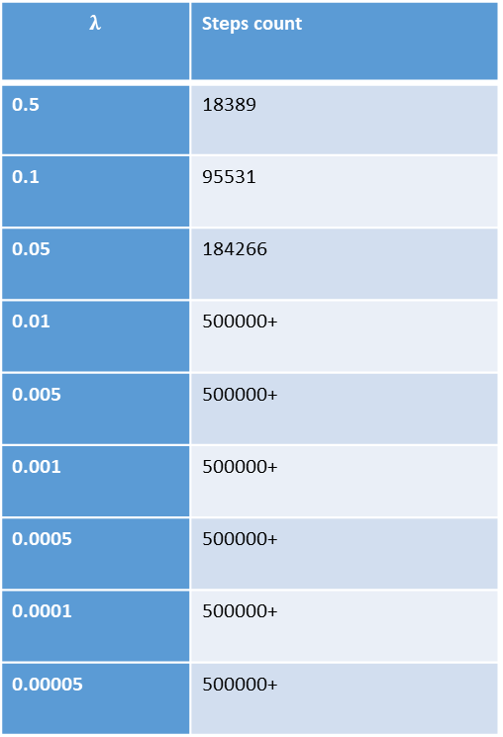
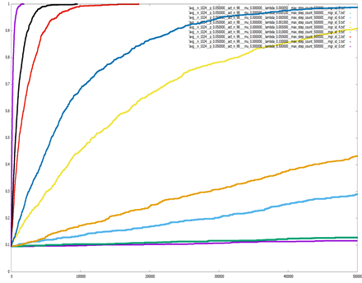
Algorithm A
𝑁=1024, 𝑝=0.5, μ=0.0

Slide 15
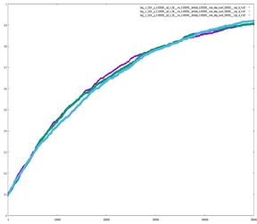
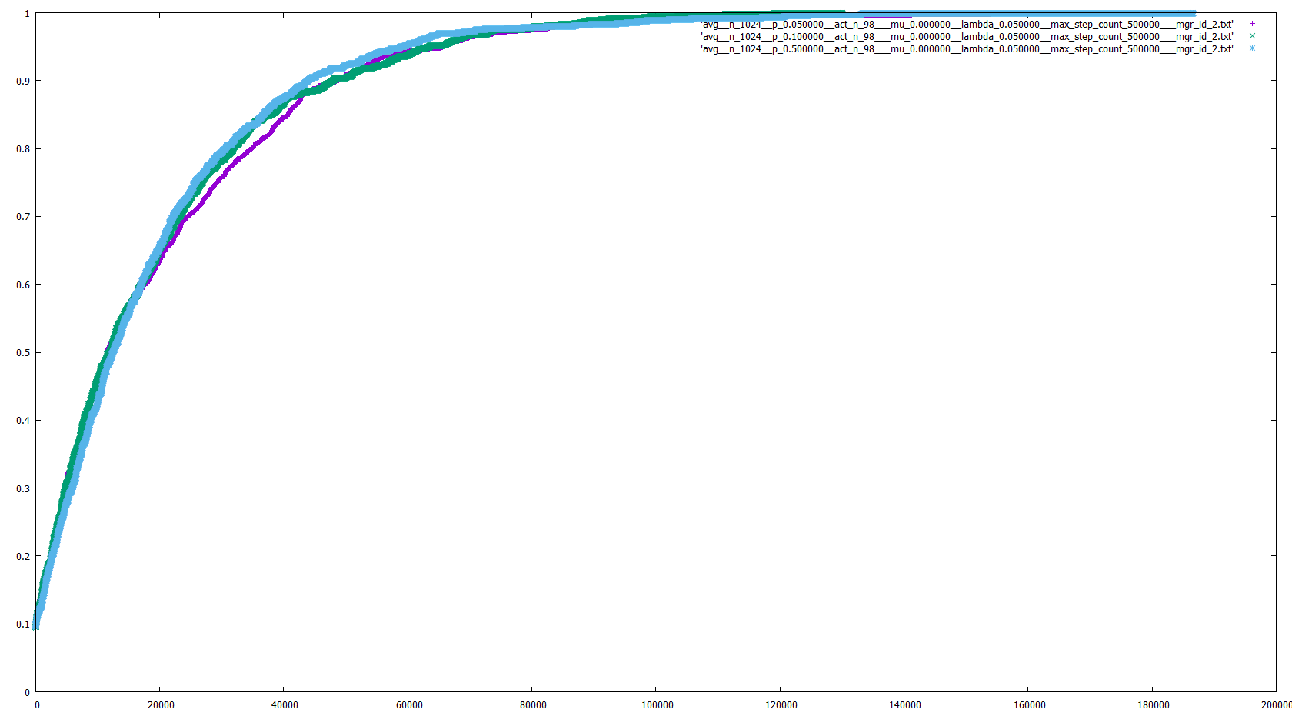
Algorithm A
P={0.5, 0.1, 0.05} λ = 0.005
P={0.5, 0.1, 0.05} λ = 0.05

Slide 16
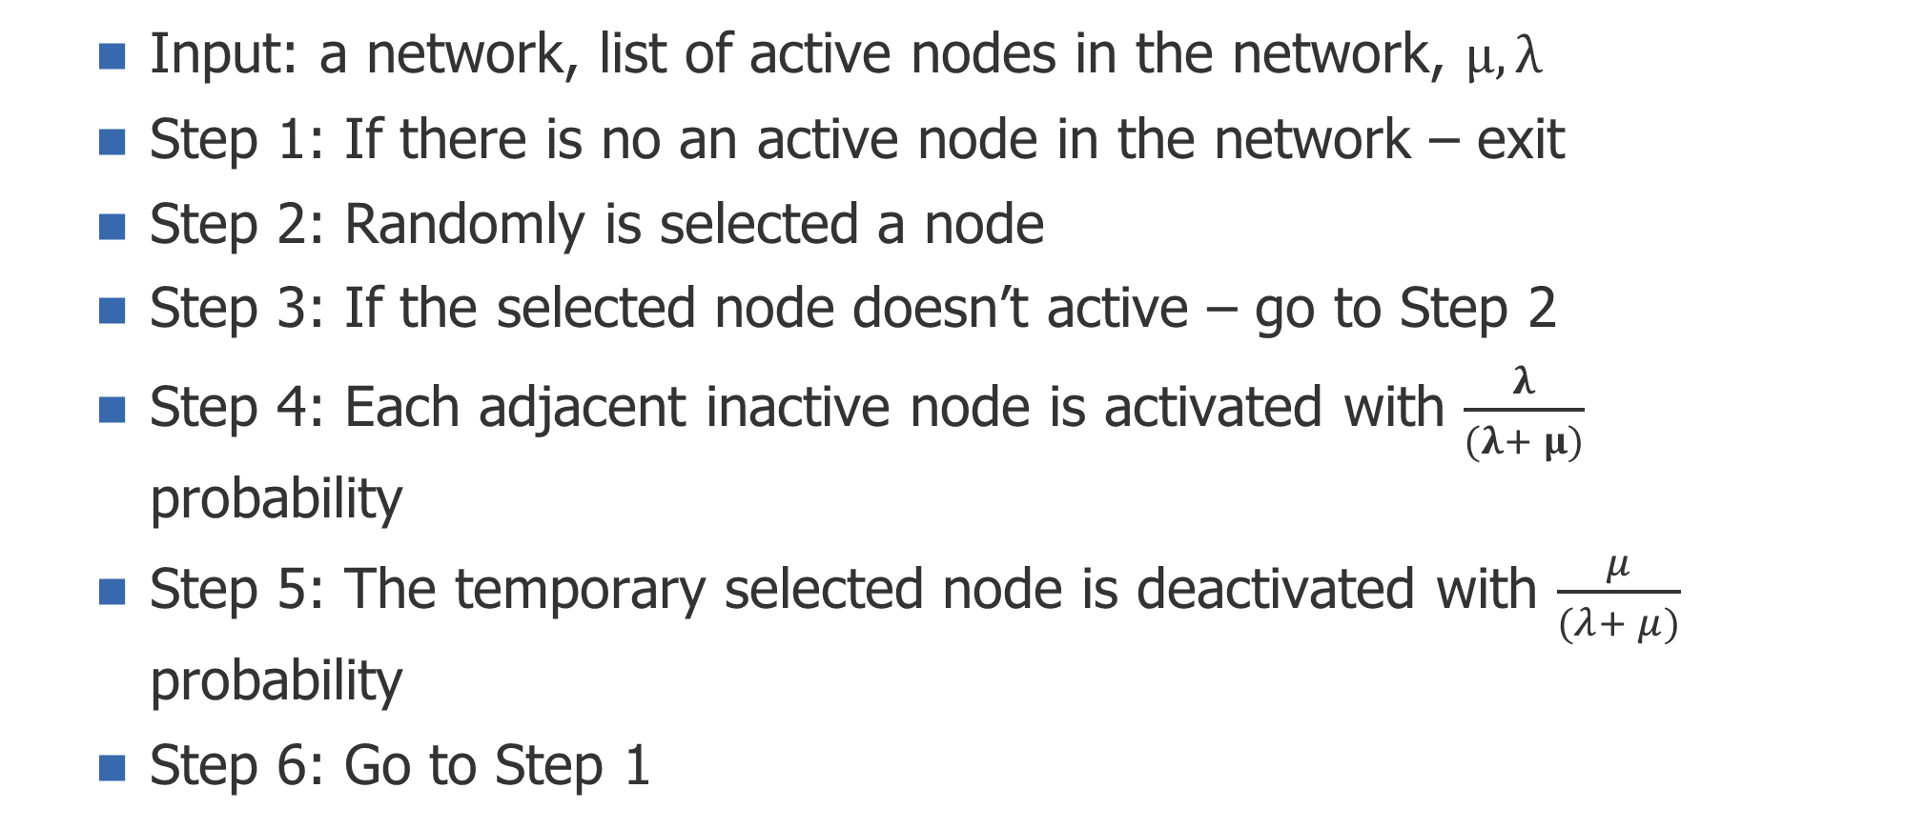
Algorithm B
Input: a network, list of active nodes in the network, $μ, λ$
Step 1: If there is no an active node in the network – exit
Step 2: Randomly is selected a node
Step 3: If the selected node doesn’t active – go to Step 2
Step 4: Each adjacent inactive node is activated with $\frac{λ}{(λ+ μ)}$ probability
Step 5: The temporary selected node is deactivated with $\frac{μ}{(λ+ μ)}$ probability
Step 6: Go to Step 1

Slide 17
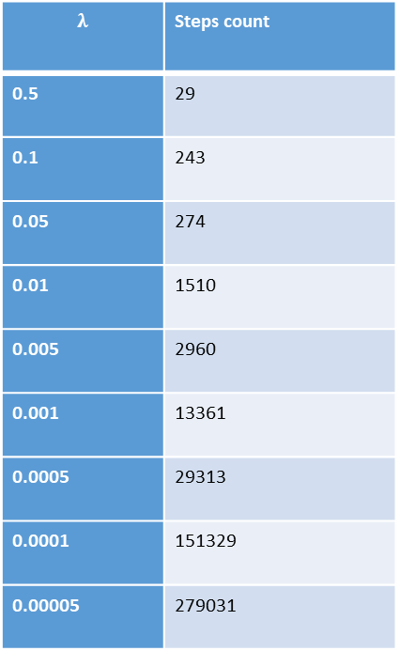
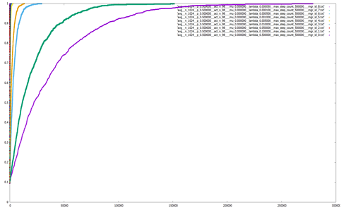
Algorithm B
N=1024, p=0.5, μ=0.0

Slide 18
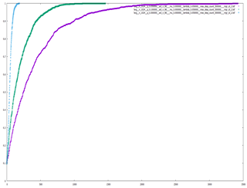
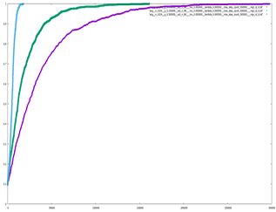
Algorithm B
N=1024, P = {0.5, 0.1, 0.05}, λ = 0.05
N=1024, P = {0.5, 0.1, 0.05}, λ = 0.0005

Slide 19
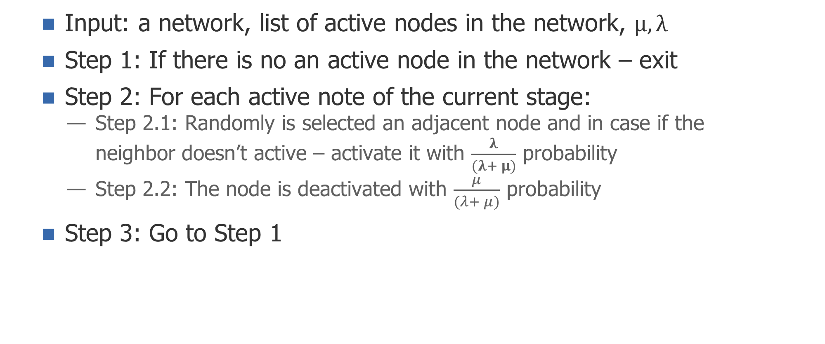
Algorithm C
Input: a network, list of active nodes in the network, $μ, λ$
Step 1: If there is no an active node in the network – exit
Step 2: For each active note of the current stage:
Step 2.1: Randomly is selected an adjacent node and in case if the neighbor doesn’t active – activate it with $\frac{λ}{(λ+ μ)}$ probability
Step 2.2: The node is deactivated with $\frac{μ}{(λ+ μ)}$ probability
Step 3: Go to Step 1

Slide 20
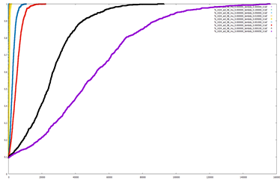
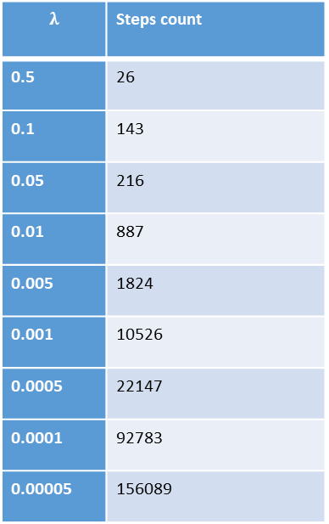
Algorithm C
N=1024, p=0.5, μ=0.0

Slide 21
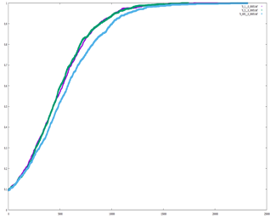
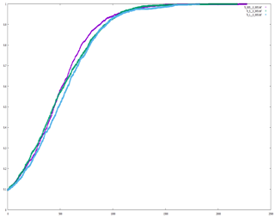
Algorithm C
N=1024, P = {0.5, 0.1, 0.05}, λ = 0.0005
N=1024, P = {0.5, 0.1, 0.05}, λ = 0.0005

Slide 22
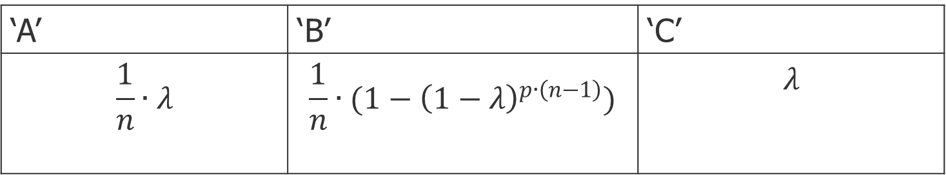
Common behavioral characteristics of the process
ER(n,p), active_nodes_count = 1
The probability that in the current step will be activated at least one node:
‘A’ | ‘B’ | ‘C’
$$\frac{1}{n}∙λ$$ | $$\frac{1}{n}∙(1−{\left(1−λ\right)}^{p∙\left(n−1\right)})$$ | $$λ$$

Slide 23
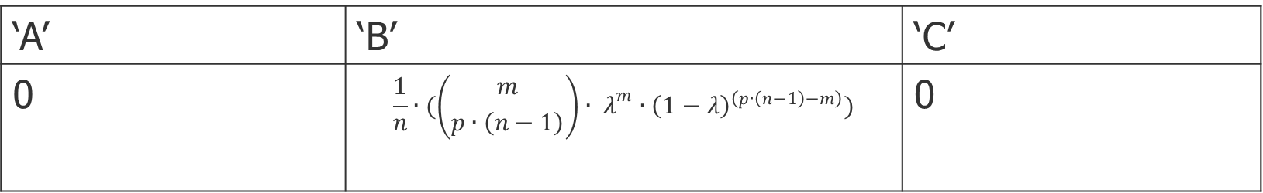

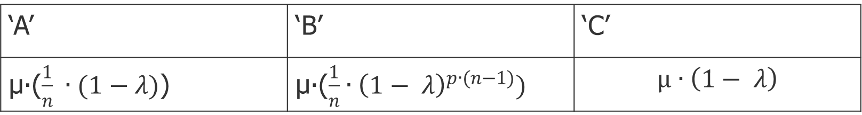
Common behavioral characteristics of the process
The probability that in the current step will be activated m / s.t $\{1<m<=p∙(n−1)$} nodes:
The probability that after the current step in the network there will be no active nodes:
‘A’ | ‘B’ | ‘C’
0 | $$\frac{1}{n}∙(\left({m \atop p∙\left(n−1\right)}\right)∙ λ^{m}∙{\left(1−λ\right)}^{\left(p∙\left(n−1\right)−m\right)})$$ | 0
‘A’ | ‘B’ | ‘C’
μ∙($\frac{1}{n} ∙(1−λ)$) | μ∙($\frac{1}{n}∙{\left(1− λ\right)}^{p∙(n−1)})$ | $$μ∙\left(1− λ\right)$$

Slide 24
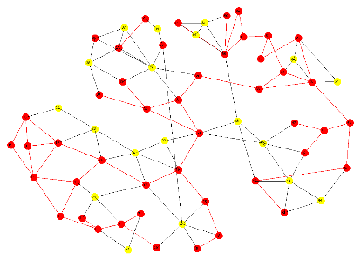
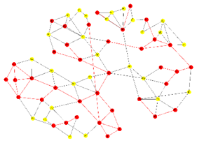
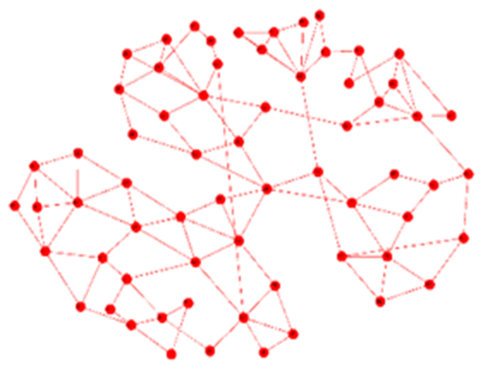
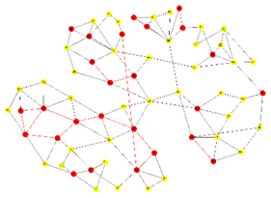
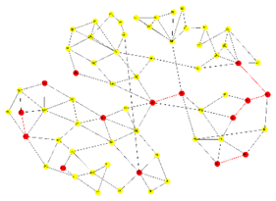
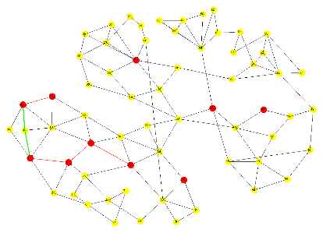
A visual representation of the process
ER(n, p) / n=65, p = 005, active_nodes_count=65, $λ=0.314159265$, μ=1.0
0 | 20 | 30
50 | 500 | 1500

Slide 25
Core characteristics of the software
Accuracy
Efficiency
Platform independency

